Slide 2
Research Development for the Research Administrator:
Working Hand in Hand
Lauren Gee, Research Administration Manager, Dept of Medicine
Shanon Hankin, Grant Development Specialist, CALS

Slide 3
Objectives
To understand the definitions and fundamentals of proposal development
To gain an understanding of the advantages of utilizing research development in the research administration process
To gain tips, tricks, and best practices to utilize on a variety of proposals

Slide 4
Poll 1
How much do you know about research development?
Notes:
https://www.polleverywhere.com/multiple_choice_polls/pzO1IzamBzB4nFIa92ZNX

Slide 5
Definitions
“A university research administrator is a knowledgeable, skilled individual committed to providing financial and administrative management for academic research endeavors in colleges and universities. Research administrators provide the needed administrative and financial support services necessary to develop and maintain outstanding research programs in the organizations they serve.”—NCURA
“Research Development encompasses a set of strategic, catalytic, and capacity-building activities that advance research, especially in higher education. Research Development professionals help researchers become more successful communicators, grant writers, and advocates for their research. They help researchers bring new ideas to life.”--NORDP
RA
RD
Notes:
NCURA was established 1959 with the spike of post-war federal grant funding into research, spiking up even more in Cold War
NORDP established in 2010 from informal network

Slide 6
Activity 2
What are some day-to-day activities you do when working on proposals/pre-award?
Notes:
https://www.polleverywhere.com/free_text_polls/eiijz6g7iNcxfBPjsqWIF

Slide 7
Role Responsibilities
Knows institutional policies on research
Understands sponsor terms and conditions, guidance
Assists in proposal development and submittal
Award set up
Manage and process financial expenditures and transactions
Manage adherence to terms and conditions
Finding funding
Linking with other resources and/or teaming partners on campus
Conduct research on agencies for proposal matching
Develop processes and practices for proposal teaming
Project management of internal/external stakeholders
Consultation on writing elements of the project/editing
RA
RD

Slide 8
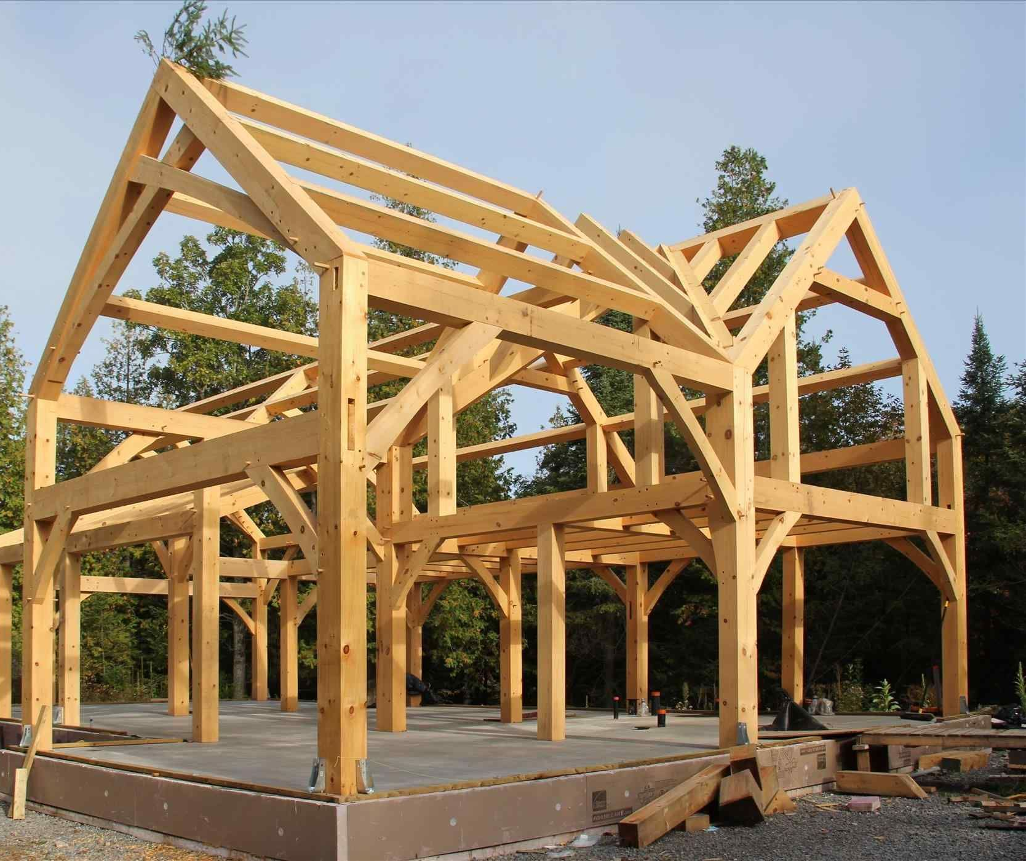
But Why Does It Matter?
More successful proposals
The way of the future for sponsors
Stronger teams
Future partnerships

Slide 9



Considerations and Realities
Time
Bandwidth
Expertise
Notes:
The goal today is tips and tricks—but this is a whole separate role for someone. It can invigorate your practice!
-Encourage “earlier I get, more I can help”
-Staffing? Who can assist? Shared resources
-Grow what you know!

Slide 10

Research Development is Alive at UW!
CAMPUS
  Sustainability Research Hub (SRH)
COLLEGE
  CALS Grant Development, College of Ag
  medRISE, SMPH
  Research Services, College of Engineering
DEPARTMENT
  Research Services, Department of Medicine
CENTERS
  Research Services, WEI
…and growing!
Notes:
Plug Community of Practice!

Slide 11
RD to Get Ahead
Research Development | Pre-Award (proposal) |  |  |  | Post-Award (project implementation)
 | Proposal Creation | Submission | Sponsor Review | Negotiation / Award Set up | Award Spending & Monitoring |  |  |  | Reconcile & Closeout
 |  |  |  |  | Budget Period 1 | Budget Period 2 | Budget Period 3 | Extension

Slide 12
Standard Timeline
Project Idea
Track Funding Opportunities
Proposal Submission
Proposal Creation
Internal Policy
5 business days prior to submission deadline
June
18 Nov
DUE to sponsor Nov 25

Slide 13

Area of Assistance 1: Pre-Proposal
Notes:
Confident and empowered

Slide 14
What Opportunities are there for RA engagement in RD?
Project Idea
Track Funding Opportunities
Proposal Submission
Proposal Creation
Internal Policy
5 business days prior to submission deadline
Learn PI Interests & Vision
Regularly Monitor & Send to PIs
Coordinate to Offer more Support
Lead the Monitoring of Progress
June
18 Nov
Sponsor Review
New Partners
New Ideas
Funding Secured
Notes:
Empowerment: Research admins can (and should!) engage in proposal development!

Slide 15
Build Relationships & Trust
Learn PI Interests & Vision
Regularly Monitor & Send to PIs
Coordinate to Offer More Support
Lead the Monitoring of Progress
Network & Build Community
Attend Conferences
Attend Campus Events/Research Seminars (many are free)
  Read Newsletters (campus, college, department-level events)
Notes:
Consider the building of relationships . . . how to build trust with PIs and their teams
Become a community member—what events can you attend to gain a broader understanding of the research enterprise
Change and fear management

Slide 16



Area of Assistance 2: During Proposal
Oo . . . This looks good . . .

Slide 17
Role 1
Objective Mapping
Meeting Framework Map
Communication
Roles/Responsibilities Checklist
Proposal Style Guide
Notes:
Objective mapping: “relationship building,” “skill building in this area” etc
Meeting framework map:
-Explain heirarchichal discussion and equity
-Framework of timing on who should talk
-expectation building
3. Roles/Responsibilities: show our checklist
4. Proposal style guide: in the shared Box, use sponsor guide and then just make decisions. “all headed left aligned all caps,” figure names on the bottom left, etc.

Slide 18


“What does that even mean?”
“Did 10 people write this?”
“This is the 9th typo on this page!”
“My eyes hurt!”
“They said the opposite three pages ago!”
“Plain language, please!”
“This graphic is saying something else!”
“They didn’t even cite the write table!”
This Photo by Unknown Author is licensed under CC BY-NC

Slide 19
Role 2
Matching to the NOA
Play keyword catch
Communication
Writing “best practice” (tone, voice, tense)
Story consistency
Notes:
Are the weird elements of the NOA being answered (not just the rules)
What are the NOA keywords, and can you find them throughout the proposal?
Review budget justification with specific aims, research strat with the facilities (can do a fly by)
POV, tense, tone

Slide 20
Area of Assistance 3: At Submission
The Submission Communication Plan
What timeline can they expect?
How will you communicate where it is in the process?
Who will be contacted if edits are required?
Who can view RAMP? Who can edit?
How and when will you let them know it’s submitted?
What will you send post-submission?

Slide 21
Area of Assistance 4: Post-Proposal Follow Up
Project Idea
Track Funding Opportunities
Proposal Submission
Proposal Creation
Meet with Program Officer
Meet with Partners to Discuss Review
Send New Funding Opportunities
Follow Up
Sponsor Review
New Partners
New Ideas
Funding Secured
Notes:
Debriefs to encourage future partnering

Slide 22
Activity 1: Case Study
You have a PI from Mechanical Engineering who comes to you with the idea for a project. It involves studying the use of energy-efficient portable stoves. She is considering exploring areas of lung disease associated with the stove, and environmental elements.
How would you assist?
Pre-Proposal
At Proposal
Submission
Post-Proposal

Slide 23
Consider . . .
Who? -Who’s involved? -How and when will you contact them? -What will you do to stay in touch? | What? -What are some important tasks? -How can you delineate who does what?
When? -What’s the timeline for this—what should be done when, how far from the deadline? | How . . . Do we integrate? How could some of the typical Research Admin tasks at this stage be injected with Res Dev?

